Slide 1
ACS 560 Course Project: UML Diagrams
Kevin Villela
Phillip Bercot

Slide 2
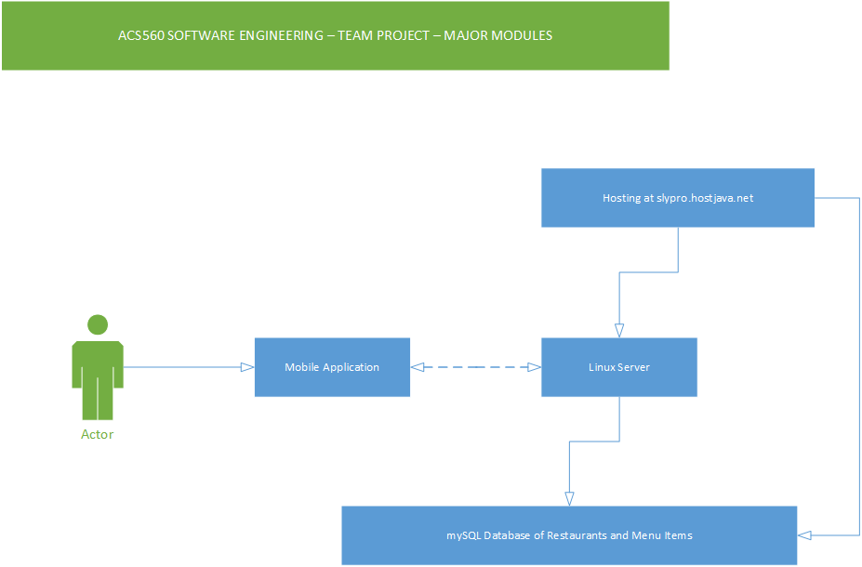
Major Modules

Slide 3
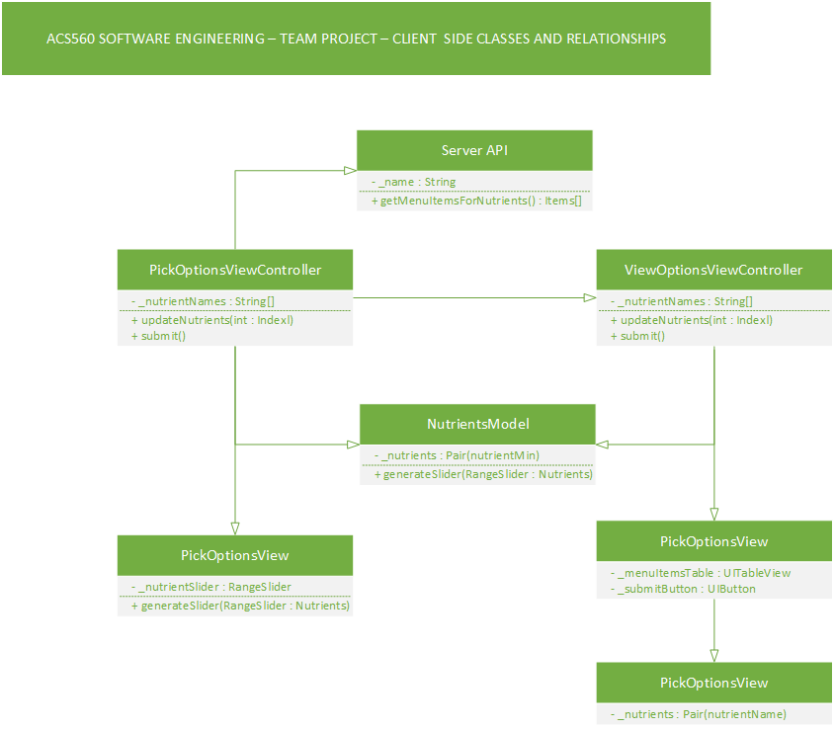
Client-Side Class Diagram

Slide 4
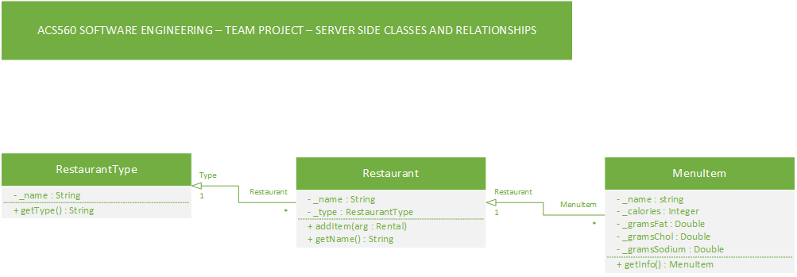
Server-Side Class Diagram

Slide 5
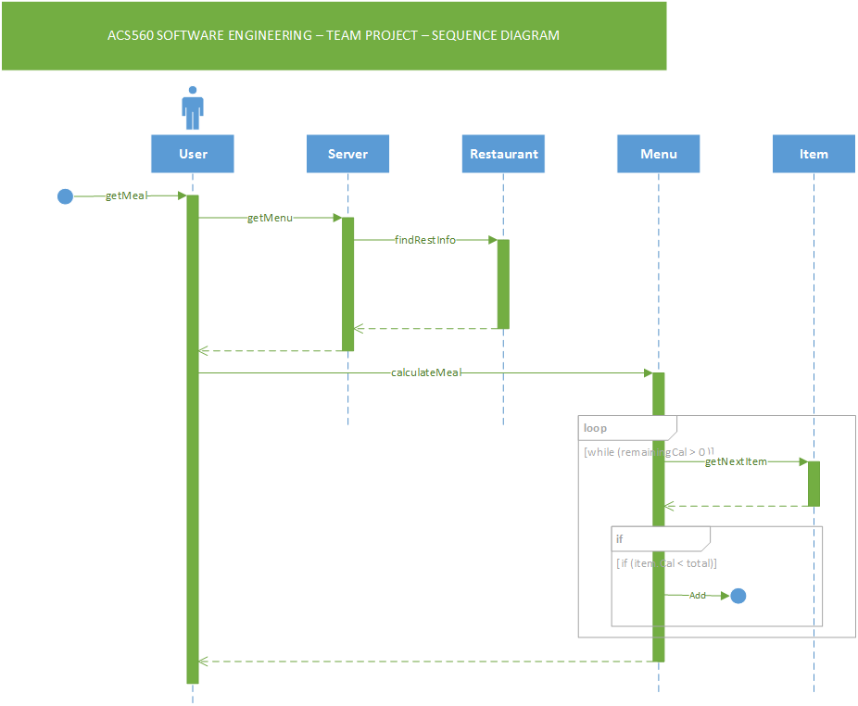
Sequence Diagrams

Slide 6
Q&A
Any questions?

